Slide 1

Project 2: TinyHub
T1.1908.M0 – Group 1:
- Bùi Gia Hưng 1219675
- Đặng Xuân Quang 1219675 - Nguyễn Đức Anh 1219675

Slide 2


--Our World--

Slide 3

TinyHub – Ecommerce Website
www.TinyHub.com

Slide 4
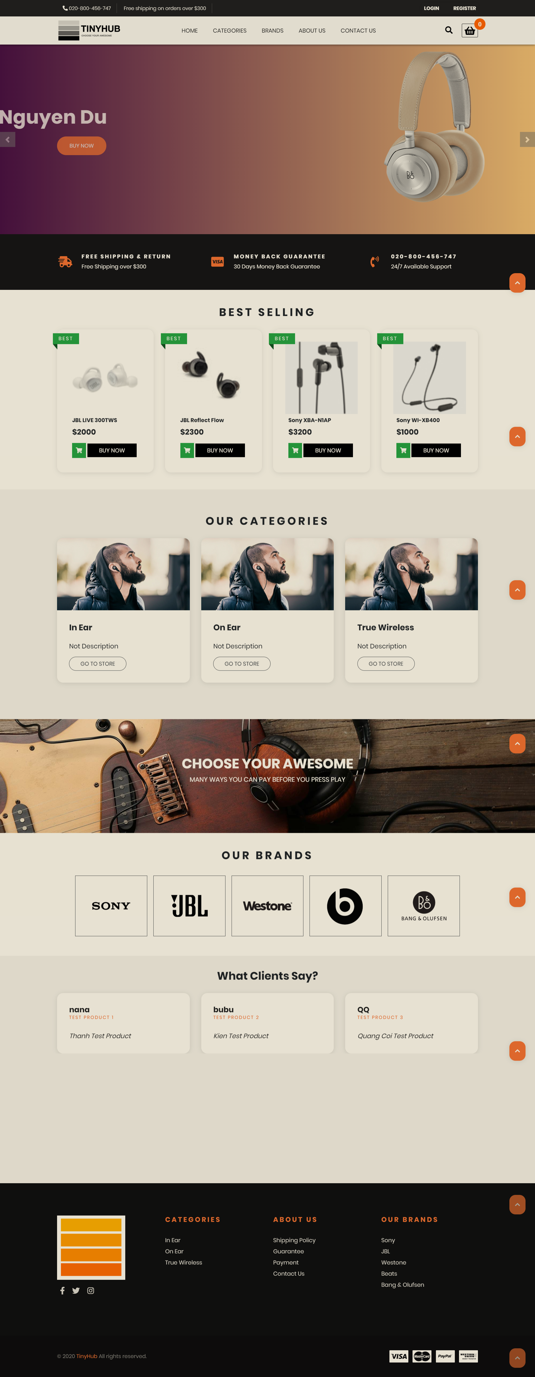
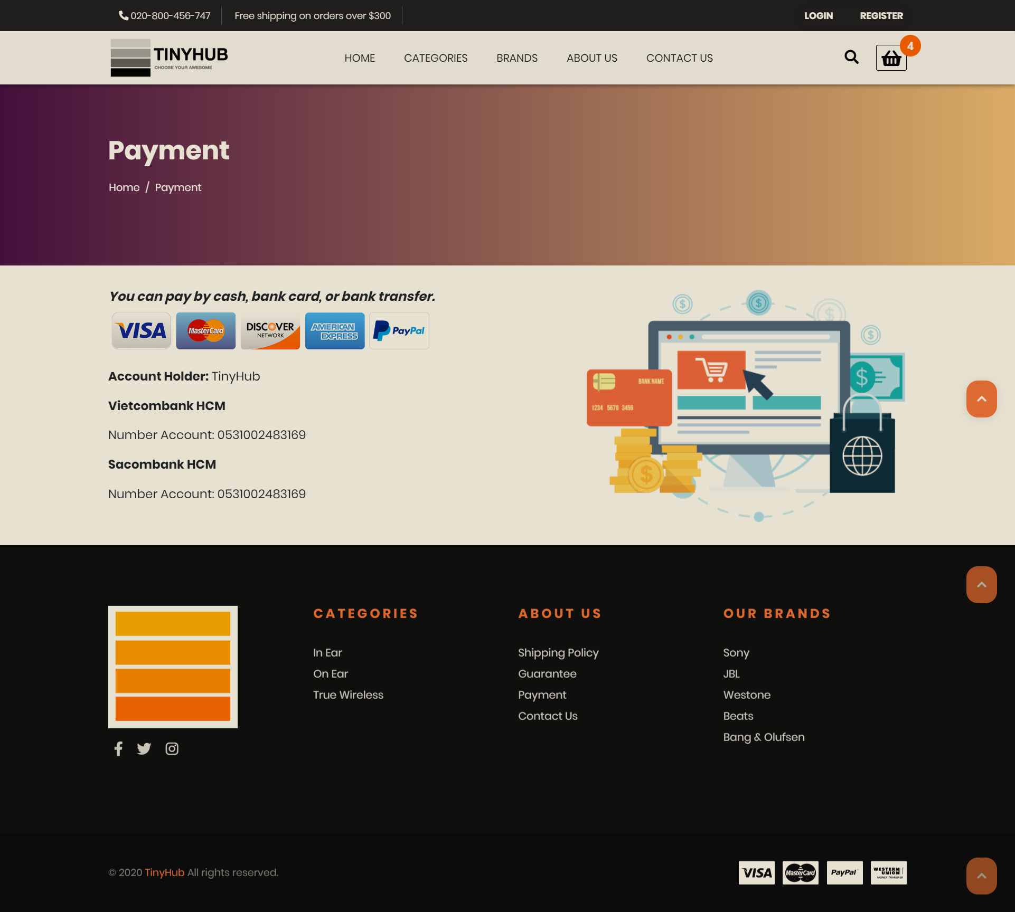
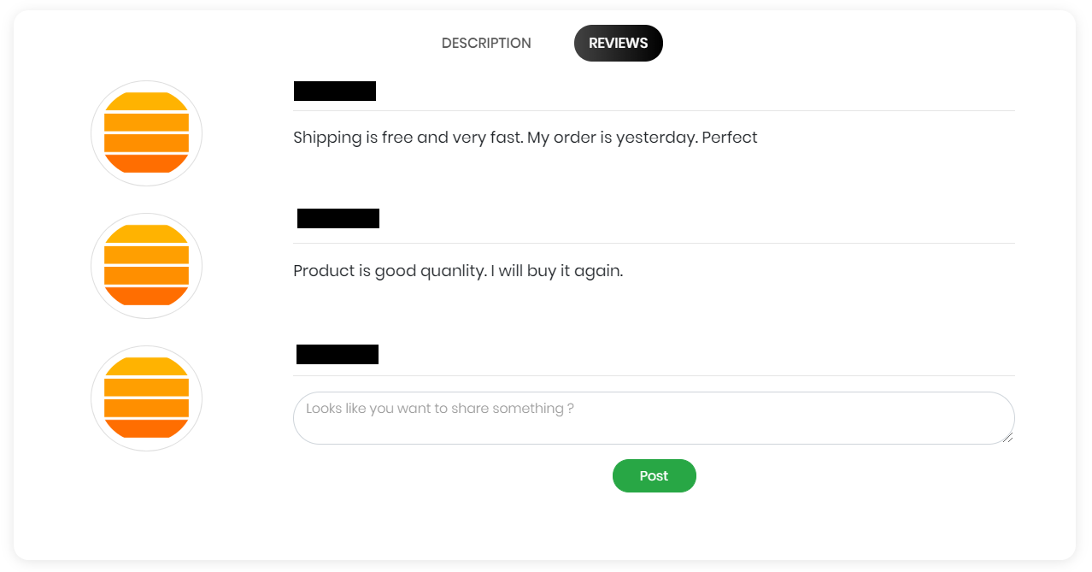
www.TinyHub.com

Slide 5

www.TinyHub.com
Client:
- Homepage, Category, Brand.
Admin:
- CUD Category.
- CUD Brand.
- CRUD Products.

Slide 6

www.TinyHub.com
Client:
- Login + Register, Feedback, Shopping cart.
Admin:
- UD User, Dashboard.
- CRUD Banner.
- Confirm, Reply Feedback.

Slide 7

www.TinyHub.com
Client:
- Profile, Product-Details, Review.
Admin:
- CRUD Customer.
- RUD Order.
- RUD Comment.

Slide 8
www.TinyHub.com
Begin: 03-June-2020
~~~~~~~~~~~~~~~~~~~~~~~
~~~~~~~~~~~~~~~~~~~~~~~
Finish: 17-July-2020

Slide 9
www.TinyHub.com
Upside:
1) Used basic function of Laravel. 2) Full options for client, admin too.
3) Good UX/UI.
4) Input has been validated carefully.
5) Can release now.

Slide 10
www.TinyHub.com
Downside:
1) Function is not high technology yet.
2) Don't test with IE yet.

Slide 11
www.TinyHub.com
Thank you for listenning

